Slide 1
Senior Design Project A ROBOT TO Autonomously locate and transport severe disaster victims to care facility
TEAM 6:
TEAM MELTDOWN

Slide 2
Objectives
4 wheel autonomous robot.
Navigate self through flat and grassy terrain without damaging board.
Navigate board without crossing “river”.
Locate victims, pick them up, and return them to a drop-off point.
Return victim to correct drop-off point based on color.
Return to home location.

Slide 3
Who We Are ? – The Team Meltdown
Mansi Shah [Electrical/Power]
Taylor Morrissey [Mechanical]
Shayan Bani Ardalan [Sensors/Navigation]
Jacob Nebgen [Embedded/Control]
Collin MacDonald [Programming]

Slide 4
Where Did We Start?
Good Foundation plays a key role in the success of any engineering project, so we started with finding a good foundation for our robot, the chassis.
Things We Kept In Mind While Searching Chassis :
Appropriate size to provide required agility to take necessary turns as well as to fit in paths.
Ability of motors and wheels to allow robot to operate on both paved and non-paved (grass like) surface.
Enough slots to mount Power supply, sensors, gripper and Micro Processor/controller board.
And we Landed our choice on…….

Slide 5
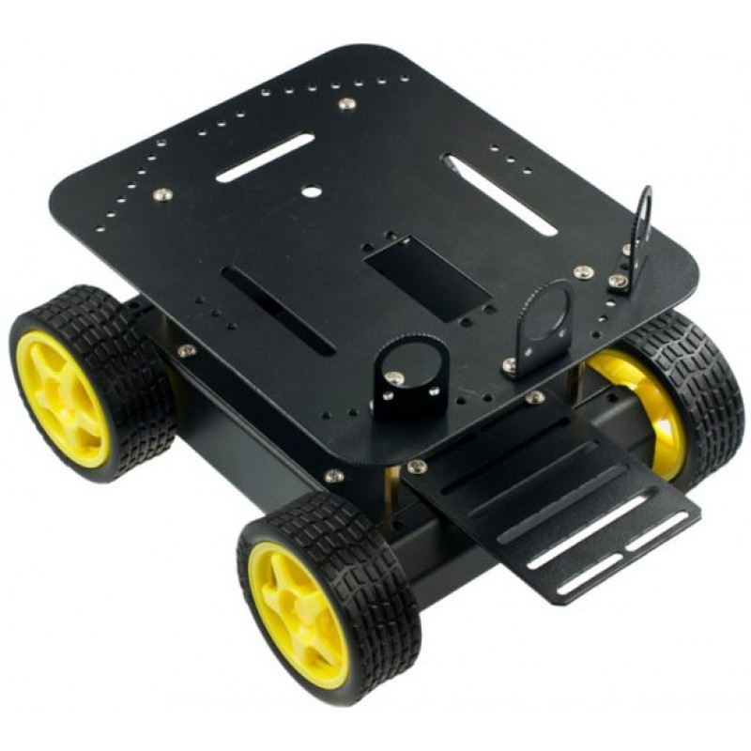
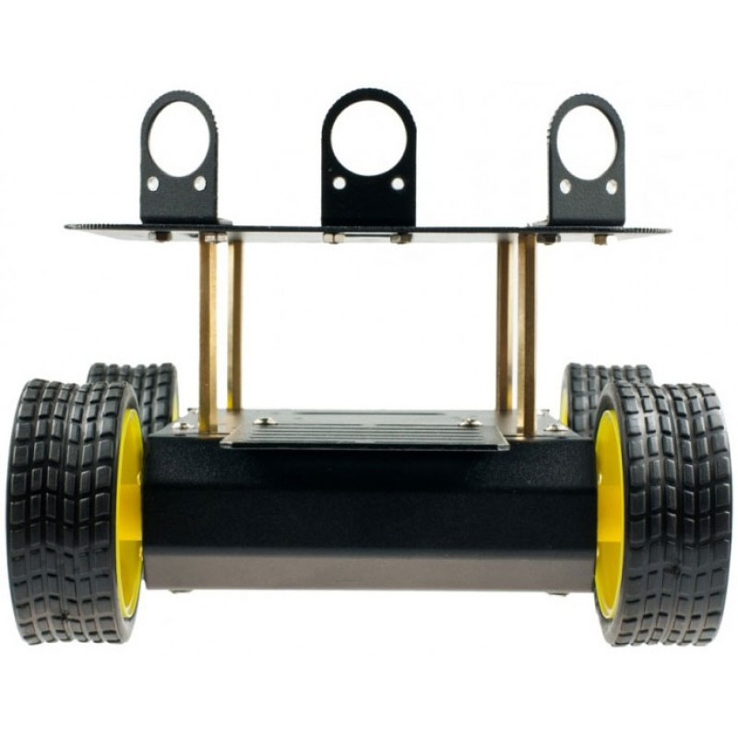
DFRobot 4WD Arduino Mobile Platform
Comes with 4 motors which can operate at its maximum speed on 6V power supply.
Has front mounting slots for gripper.
Wheels can work on normal and grass like surface.

Slide 6
Mechanical/assembly
Gripper-Popsicle Stick Prototype
Battery Upgrade and Tire Modification

Slide 7
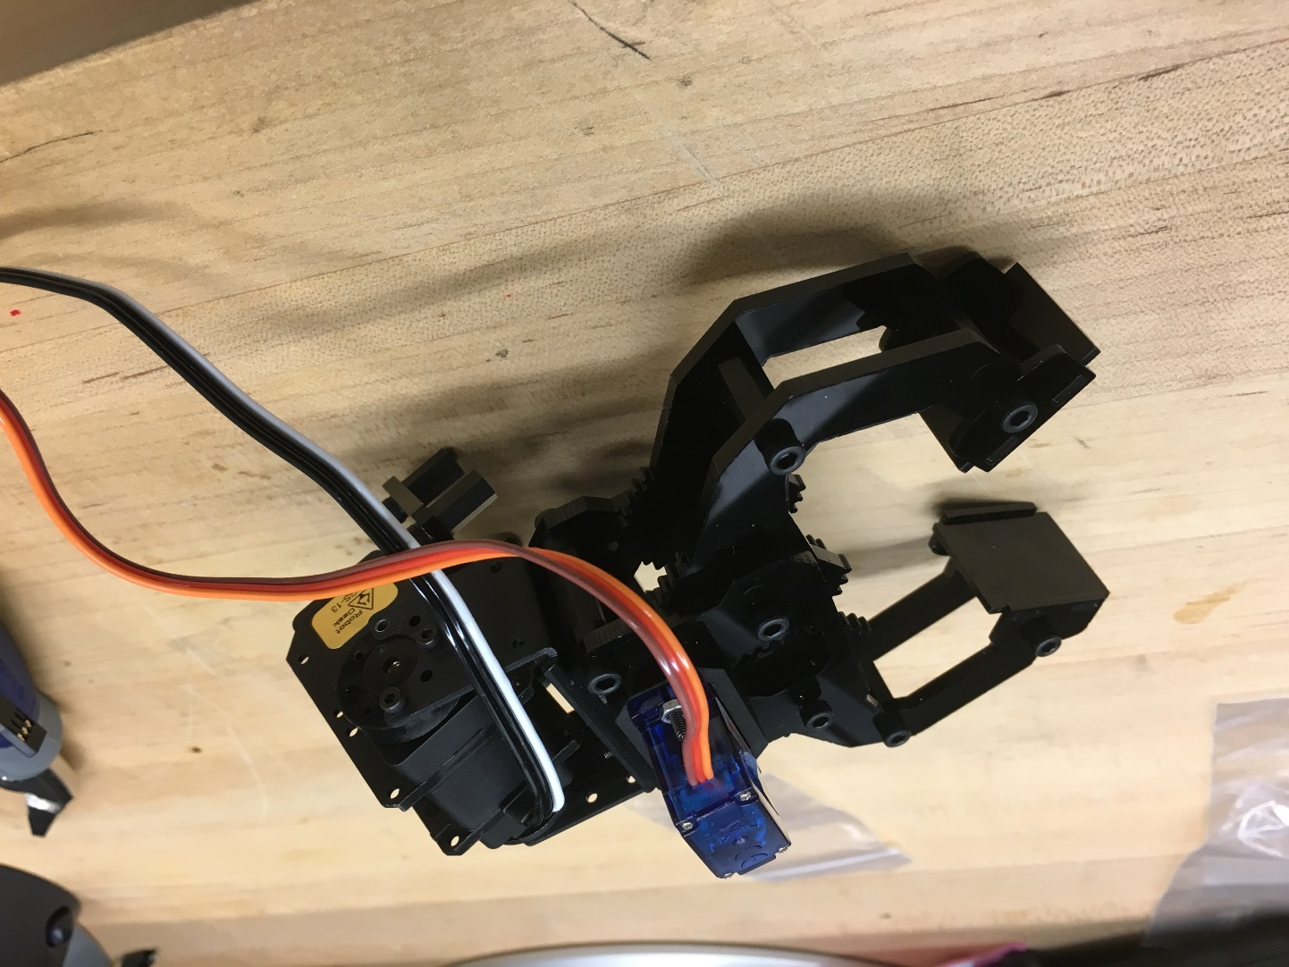
Gripper

Slide 8
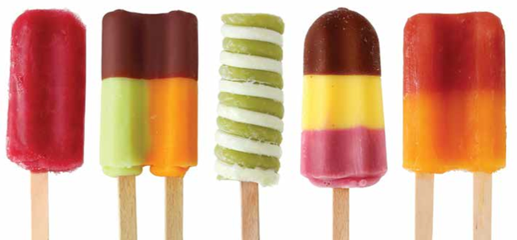
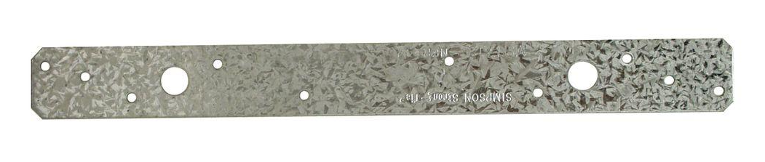
Gripper-Popsicle Stick Galvanized Basket Prototype

Slide 9
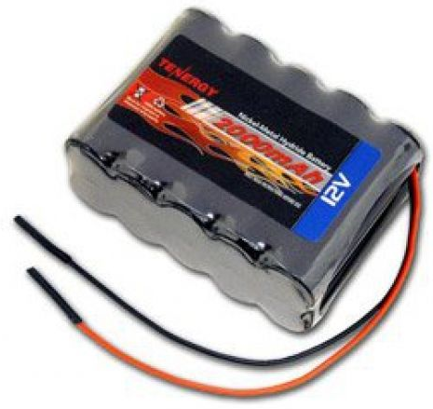
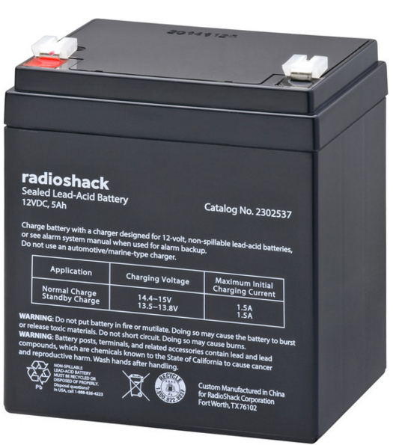
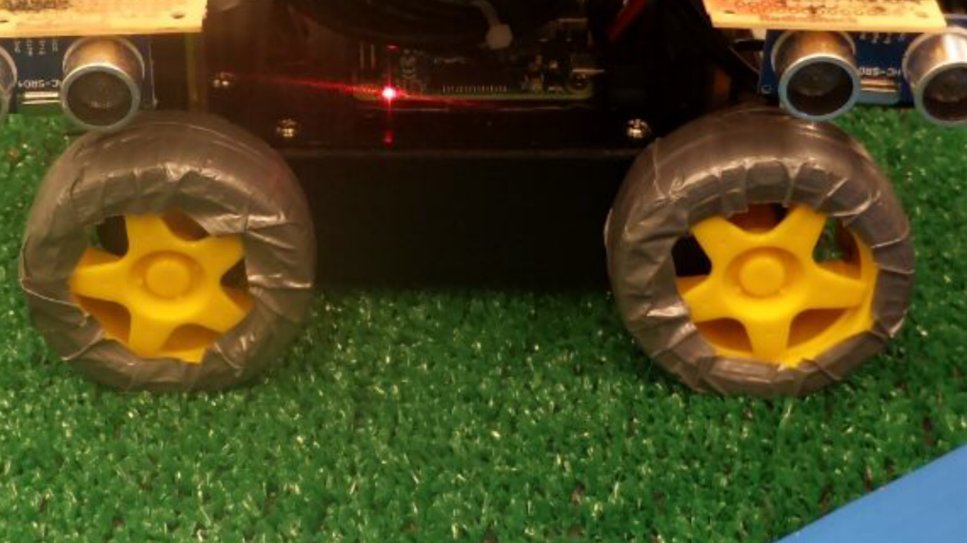
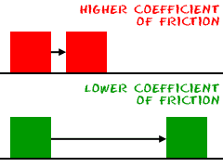
Duct Tape on Wheels

Slide 10
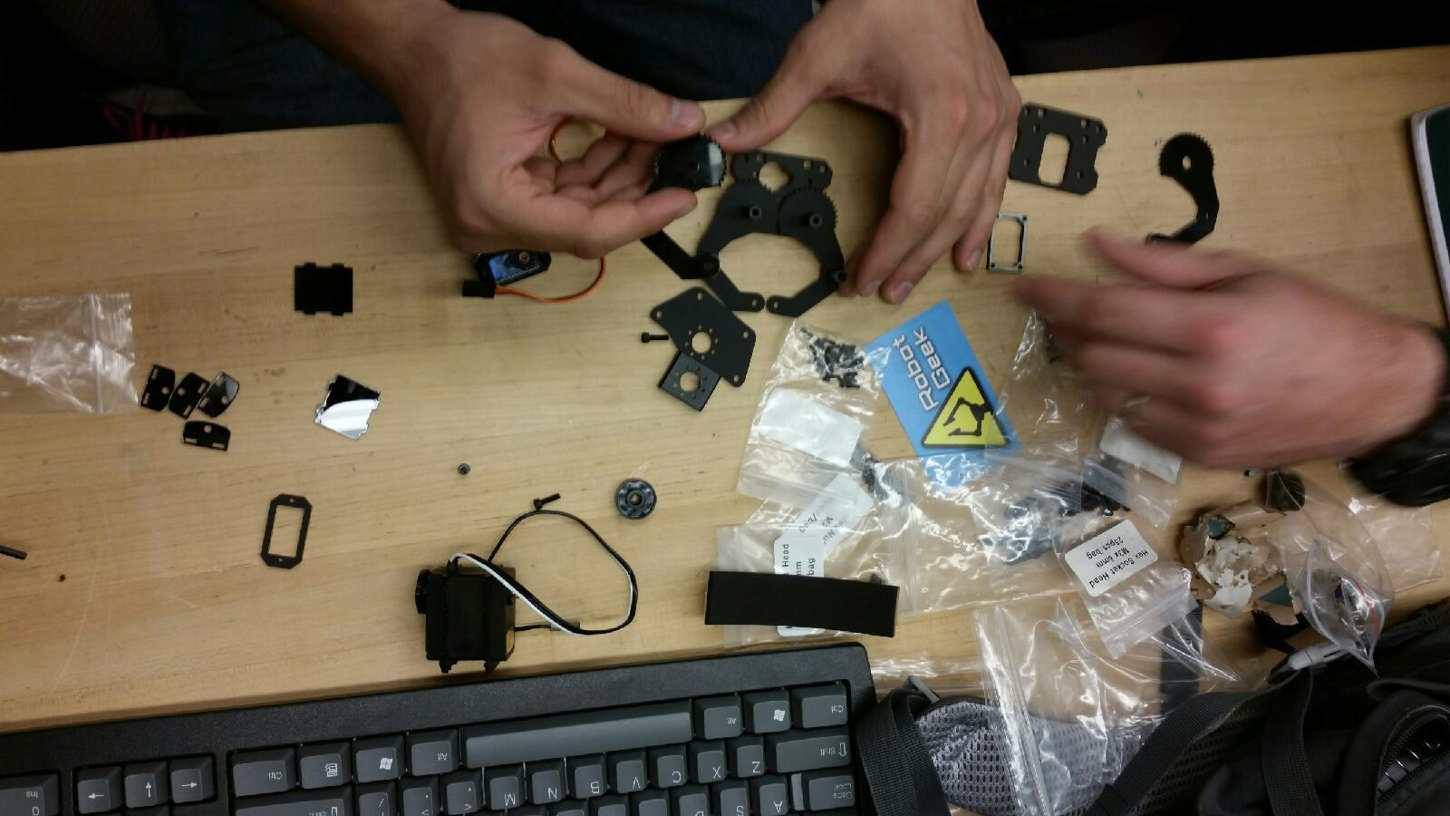

Slide 11
Electrical / Power
As we have already talked about the all the mechanical blocks of our robot, now lets talk about something which brings them to life – Power, voltage & current.
We need to power up various components in our circuit like Motors, sensors, Arduino, raspberry pi 2, gripper motor, Arduino motor shield etc
As Both motors on left would always operate on same direction we decided to fuse it together in parallel to make left and right unit.
Here is the high level circuit diagram to illustrate all power connections

Slide 12
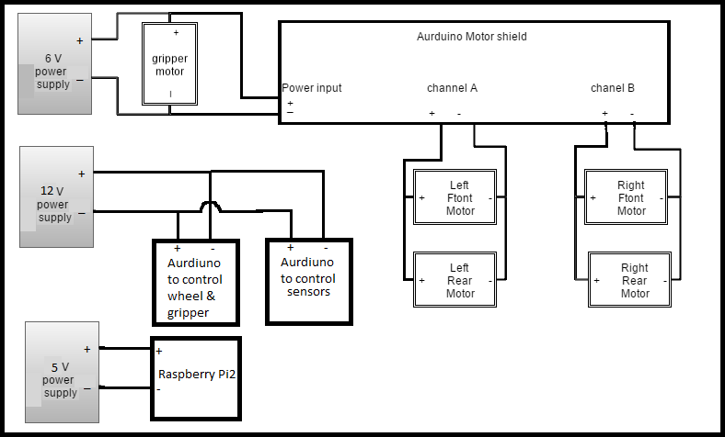
What did we stated with ?

Slide 13
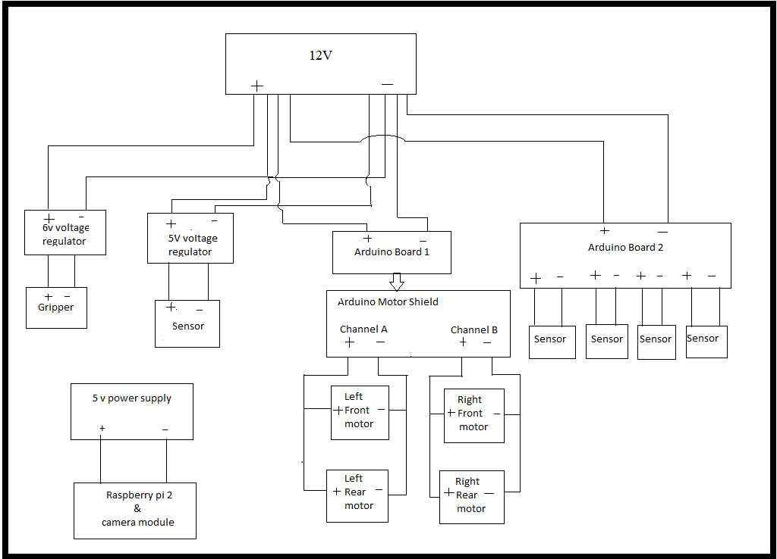
The Final design

Slide 14
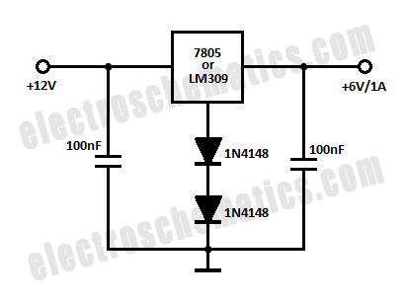
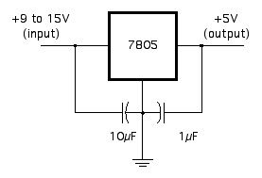
The part we made from scratch
We made 5 and 6 volt voltage regulator circuits from to power few component of our robot
We made it using basic components like LM7805, few transistors & capacitors
Source: electroschematics.com

Slide 15
Challenges
Had to rebuild voltage regulators after they get burnt caused by faulty connection during testing. Fortunately we had spare component to rebuild it.
Change of Battery on the day before competition. Had to remount components.

Slide 16
What we could improve?
Different circuit and component for voltage regulator circuit. LM7805 circuit current issue and mitigation.
We could have selected more powerful battery instead of selecting battery that just met our power requirement. We could have avoided last minute changes.

Slide 17
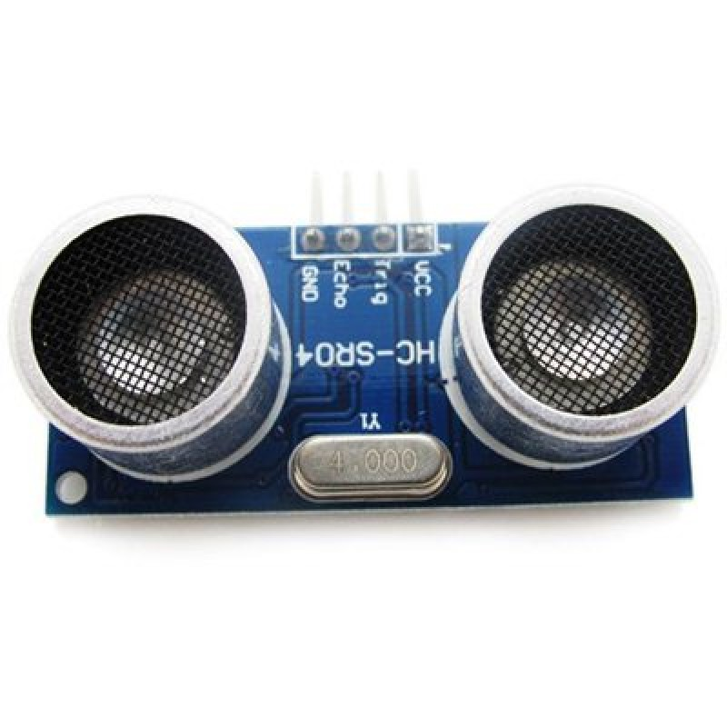
Sensors
We used HC-SR04 Ultrasonic Range Finder sensors to get feel of object/obstacles around robot.
Initial plan was to use sensor with raspberry pi2 but it turned out writing code in Arduino is much simpler
We started off with writing simple test code which checks how far is object from sensor. we placed wooden block at various distance from sensor and measured its distance using sensor and results were almost accurate.

Slide 18
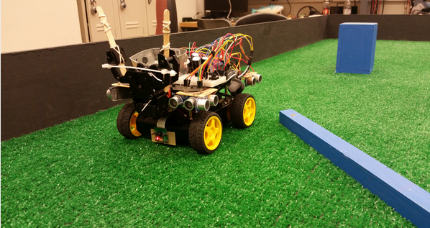
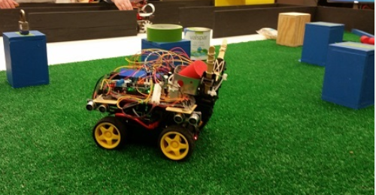
Navigation
We used Ultrasonic sensors all around the robot to understand its surroundings.
Avoided walls and navigated by keeping distance from the walls.
Used Raspberry Pi camera module to detect the victims based on their color.
Navigated around the obstacles to avoid collisions.

Slide 19
Embedded
2 Arduino boards
More I/O pins
More processing power
1 Arduino for sensor inputs
1 Arduino for controlling motors
1 Raspberry Pi2 with Camera Module for color sensing.
We can use Mega Arduino board instead of two Arduino Uno’s to avoid asynchronous processing.
Motor
Camera Module
HC-SR04 Sensors
Arduino 1with Motor Shield
Pi 2
Arduino 2
Gripper

Slide 20
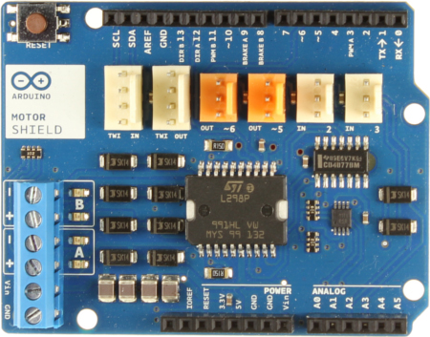
Arduino Motor Shield

Slide 21
Embedded Improvement Ideas
1 Teensy
Way more I/O pins
More processing power
Only one set of code needed for Teensy Vs two for both Arduinos
Simplifies communication
Motor
Camera Module
HC-SR04 Sensors
Teensy
Pi 2
Gripper

Slide 22
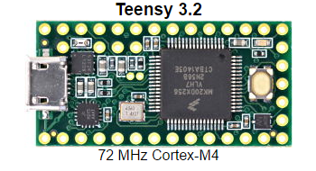
Teensy

Slide 23
Programming
Raspberry Pi 2
Python
Reading from and writing to two Arduino boards
Pull sensor readings from one board
Control gripper and wheels by writing to other board
Detecting victims
Navigating to victims
Determining color of victims

Slide 24
Communication
MOTOR SHIELD (/dev/ttyUSB0)
a = RightTurn
b = LeftTurn
c = RightWall
d = LeftWall
e = FrontAdj
f = Forward
g = RightAdj
h = LeftAdj
i = Stop
j = Neutral
k = ArmUp
l = ArmDown
m = GripperOpen
n = GripperClose
o = gripperOpenSlightly
p = reverse
q = Turf Front ADJ
r = Turf Left ADJ
s = Turf Right ADJ
Z = reset Arduino
SENSOR BOARD (/dev/ttyACM0)
a = Read Sensor1 (front driver side)
b = Read Sensor2 (rear driver side)
c = Read Sensor3 (front passenger side)
d = Read Sensor4 (read passenger side)
e = Read Sensor5 (front)
f = Blink LED
Z = reset Arduino

Slide 25
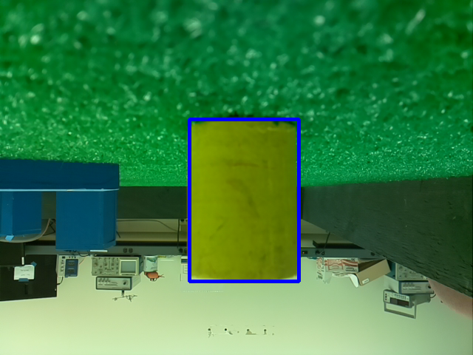
Picamera and OpenCV
cv2.inRange()
cv2.findContours()
Red
Yellow
x,y,w,h=cv2.boundingRect()
Position based on horizontal center
In position when w > 200
w
y
h
x

Slide 26
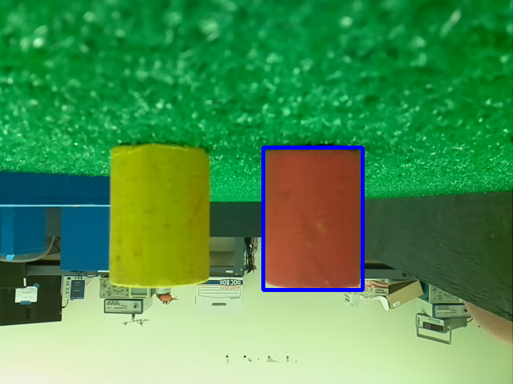
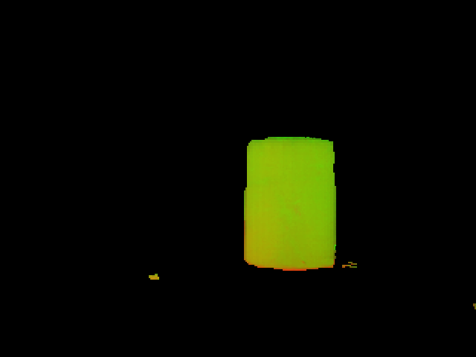
Searching for Red Victim
X+(W/2)

Slide 27
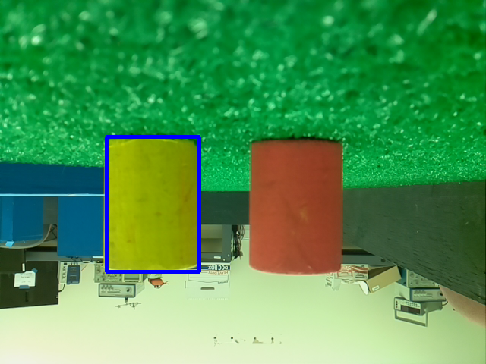
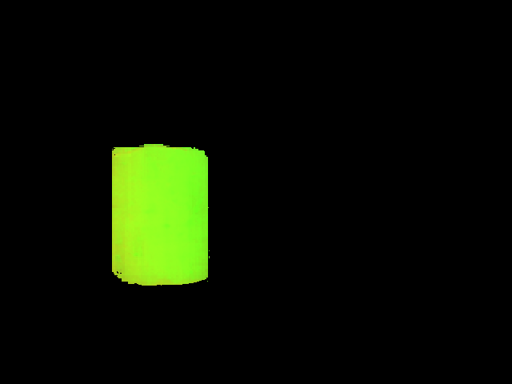
Searching for Yellow Victim
X+(W/2)

Slide 28
Challenges – Background Subtraction
HSV (Hue, Saturation, Value)
More intuitive
Auto White Balance
redLower = np.array([0,50,50])
redUpper = np.array([15,245,255])
yellowLower = np.array([20,200,100])
yellowUpper = np.array([42,255,245])

Slide 29
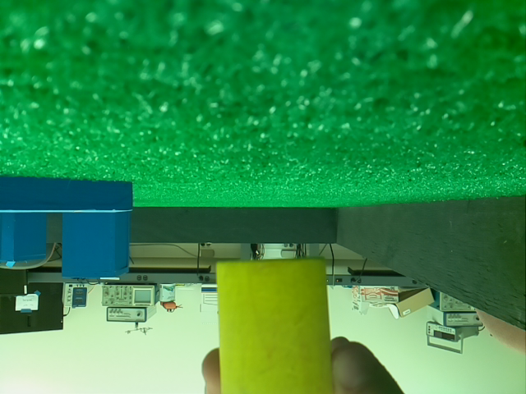
Challenges – Objects Not on Track
camera.resolution = (640, 480)
Y < 300

Slide 30
Improved Design?
Exception handling
Improve reliability
Check if victim has been picked up
Check sensor values more often
Obstacle detection
Improve speed
Concept is already in place
Utilized OpenCV more heavily for navigation
Improve reliability
Add another camera?

Slide 31
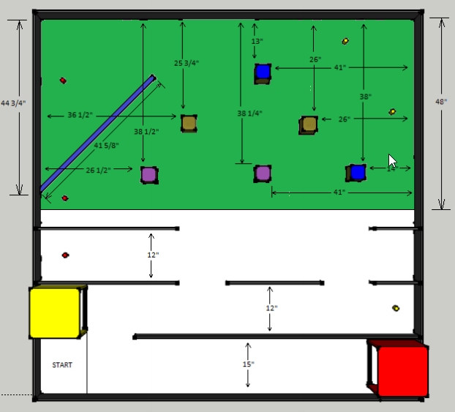
Final Behavioral Overview
2
1

Slide 32
Projected Cost
Sr. | Item | Cost
1 | Chassis | $100
2 | Gripper | $75
3 | Sensors | $25
4 | Control Boards | $50
5 | Track Construction | $50
6 | Batteries | $20
 | Projected Total | $320

Slide 33
Actual Itemized Cost
Sr. | Item | Cost
1 | Chassis | $75
2 | Gripper | $55
3 | HC-SR04 Sensors | $6
4 | Arduino Motor Shield | $23
5 | Raspberry Pi 2 | $35
6 | Camera Module | $30
7 | Edimax Wi-Fi USB Adapter | $10
8 | Track Construction | $44
9 | Tenergy 12v 2000mah Battery | $44
10 | Sealed Lead-Acid 12v-5Ah | $35
 | Total | $357
Notes:
A schedule design for optional periods of time/objectives.

Slide 34
References
https://www.pjrc.com/teensy/teensy31.html
Notes:
A schedule design for optional periods of time/objectives.

